Slide 1


Hosted by:
Servers and Databases
Where all the magic happens

Slide 2

More Workshops This Year!
https://making.engr.wisc.edu

Slide 3
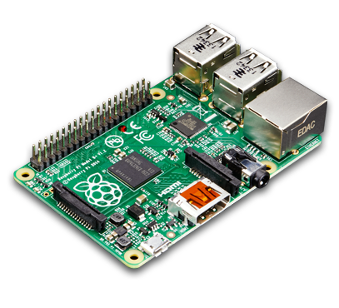
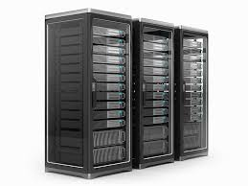


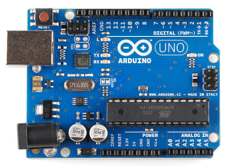

What is a Server?
Any “Computer” with a way to store data, run processes, and can connect to other computers can be a Server

Slide 4
Connect to Server
HTTP (Hypertext Transfer Protocol)
Way of sending data to servers
Just a protocol
SSH
Open a terminal
FTP
Transfer files

Slide 5
Why Protocols
Way of knowing how data is formatted
We send 2 bytes of data
4 bits for A, 4 bits for B, 8 bits for C
Here is 16 bits
0100001010100111
Or
0100001010100111
Or
0100001010100111
Or what about
0100001010100111
Bro, which bits are what?

Slide 6
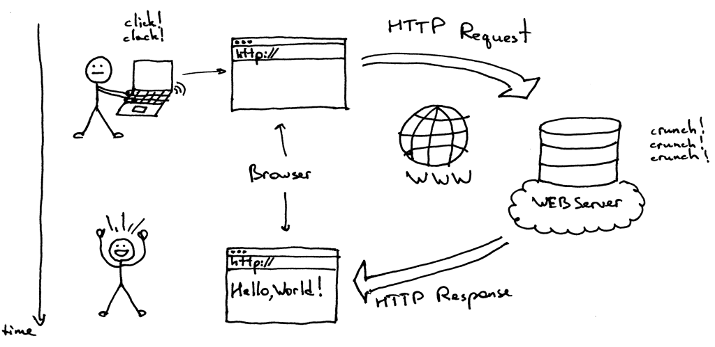
HTTP Protocol

Slide 7
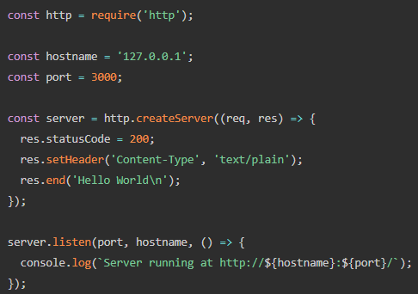
How do I run a HTTP Server?
With any language you want
Just need to be able to handle HTTP Requests
Popular Languages and Frameworks
Python and Flask
Java and Spark
JavaScript and NodeJS
Takes few lines

Slide 8
Sending HTTP Request
GET
All information is in URL/Request Line
http://myServer:8888/path/with/info/about/the/get/call
Never send passwords in here
POST
Same as GET but has a JSON Body with info
Used to send larger amount of data

Slide 9
The Response – Status Code
Response is just a JSON object
Status codes to know:
200 – We All Good
4xx’s - Client screwed up
404 Not Found
5xx’s - The Server screwed up
500 Internal Server Error

Slide 10
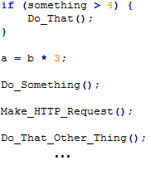
Async Programming
Code usually is synchronies or “blocking”
Might take long time

Slide 11
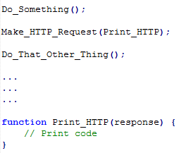
Main Thread | Callback Thread _
Make_HTTP_Request()
Print_HTTP

Slide 12
Time to get some practice!
tinyurl.com/ServerFunIEEE

